Slide 1

BTH645 - Multimedia Elements for User Interfaces
Shi, Yue (Sunny)
Office: DB2095
sunny.shi@senecacollege.ca
SENECA COLLEGE

Slide 2
Outline
Introduction to sound
Digital audio
MIDI audio
MIDI versus digital audio
Audio file formats
Next week
animation
video

Slide 3
Introduction to Sound
Introduction to Sound
https://www.youtube.com/watch?v=XLfQpv2ZRPU

Slide 4
Introduction to Sound
Vibrations in the air create waves of pressure that are perceived as sound.
Sound waves vary in sound pressure level (amplitude) and in frequency or pitch.
The amplitude controls the loudness and the frequency controls the pitch.
Sound pressure levels (loudness or volume) are measured in decibels (dB).
Sound frequency is measured in Hertz (Hz).
Frequency: the number of periods(cycles) per second.
Wave length: distance between any two points with the same cycle, e.g., crests (top), or troughs (bottom), or corresponding zero crossings.

Slide 5


Introduction to Sound
Amplitude,
Frequency,
Cycle,
wave length

Slide 6
Introduction to Sound
Humans can hear frequencies roughly between 20 Hz and 20,000 Hz (20kHz).
most sensitive in the 2000 - 5000 Hz frequency range.
Ultrasonic, sound with a frequency above the range of human hearing (> 20,000 Hz).
Infrasonic: Sound below the range of human hearing (< 20 Hz), low-frequency sound.
As for loudness (volume), humans can typically hear starting at 0 dB.
Sounds volume >=85dB can be dangerous for hearing.

Slide 7
Introduction to Sound
People perceive higher frequency sounds easier than low frequency sounds.
So even though the amplitude is higher that doesn't mean necessarily that the sounds is heard easier, it also depends on the frequency.
Low frequency sound is also less directional, it's hard to figure out where exactly it's coming from
“Acoustics” is the branch of physics that studies sound.

Slide 8
Digital Audio
Digital audio data is the actual representation of sound, stored in the form of samples.
Samples represent the amplitude (or loudness) of sound at a discrete point in time.
The quality of digital recording depends on the sampling rate (or frequency ) and bit depth.
Sampling rate (or frequency ): the number of samples taken per second. measured in kilohertz, thousands of samples per second
bit depth (sample size, resolution, or dynamic range): how many bits are used to represent the value of each sample.

Slide 9
Digital Audio
The more often you take a sample ( high sampling rate ) and
the more data you store about that sample (high bit depth),
the finer the resolution and quality of the captured sound when it is played back.

Slide 10
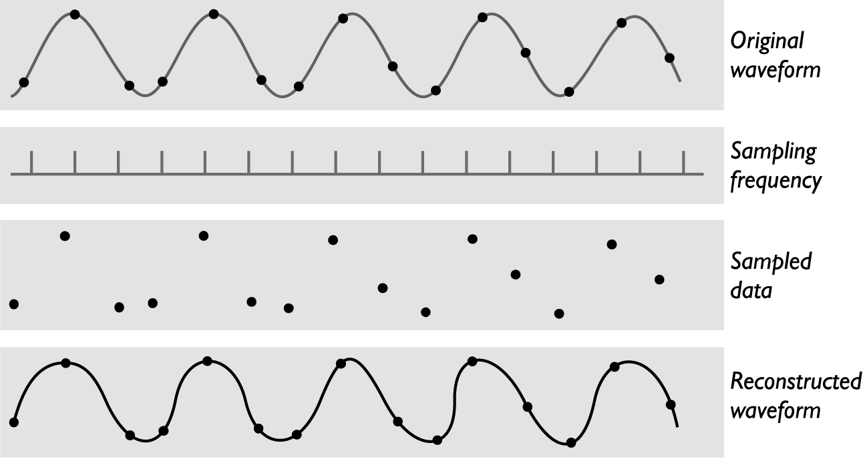

Slide 11
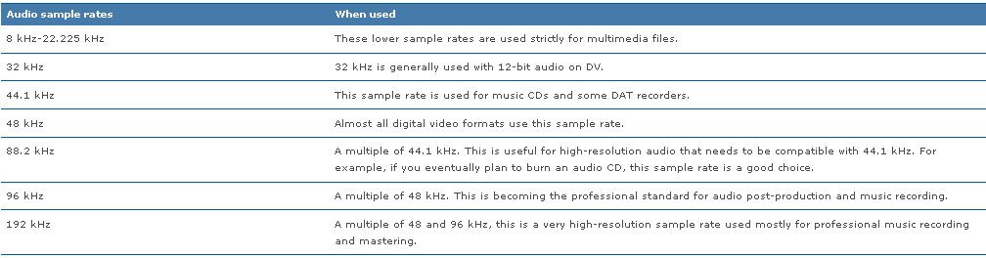
Digital Audio
For years, the digital audio sample rate standards have been 44,100 Hz (44.1 kHz) and 48 kHz.
As technology improves, 96 kHz and even 192 kHz sample rates are becoming common.
https://documentation.apple.com/en/soundtrackpro/usermanual/index.html#chapter=B%26section=2%26tasks=true

Slide 12
Digital Audio
Sample sizes (bit depth) are 8 bits, 16 bits, and 24 bits.
Compact Disc Digital Audio, uses 16 bits per sample, DVD-Audio and Blu-ray Disc, support up to 24 bits per sample.
An 8-bit sample size provides 256 equal measurement units to describe the level and frequency of the sound in that slice of time.
How about 16-bit sample size?
The larger the sample size the more accurately the data will describe the recorded sound, and bigger file size.

Slide 13
Digital Audio
The quality of audio is based on the quality of recording, not the device on which your end user will play the audio. ➔
Digital audio is device independent.

Slide 14
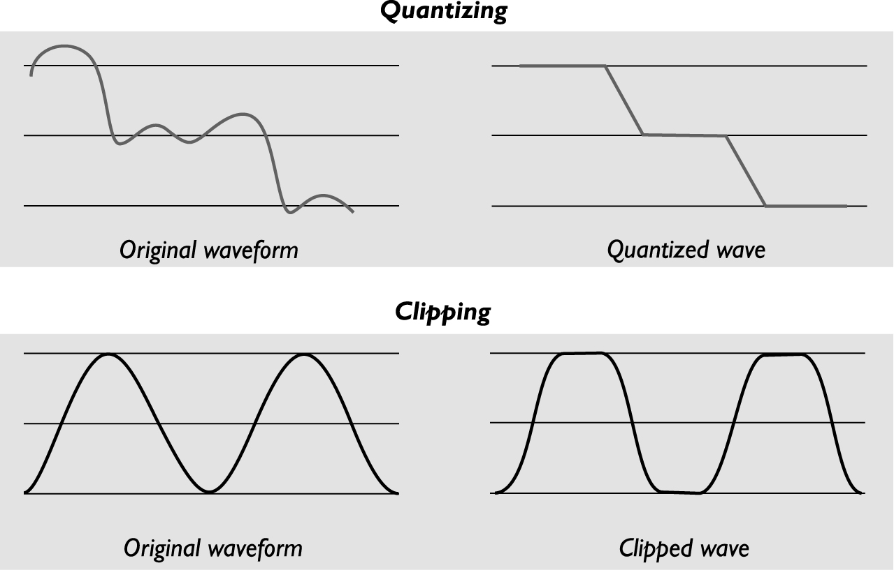
Digital Audio
The value of each sample is rounded off to the nearest integer (quantization), and if the amplitude is greater than the intervals available, clipping of the top and bottom of the wave occurs.

Slide 15
Making Digital Audio Files
Crucial aspects of preparing digital audio files are:
Balancing the need for sound quality against file size.
Setting appropriate recording levels to get a high-quality and clean recording.

Slide 16
Making Digital Audio Files
Once a recording has been completed, it almost always needs to be edited.
Basic sound editing operations include trimming, splicing and assembly, volume adjustments, and working on multiple tracks.
Additional available sound editing operations include format conversion, resampling or down sampling, fade-ins and fade-outs, equalization, time stretching, digital signal processing, and reversing sounds.

Slide 17
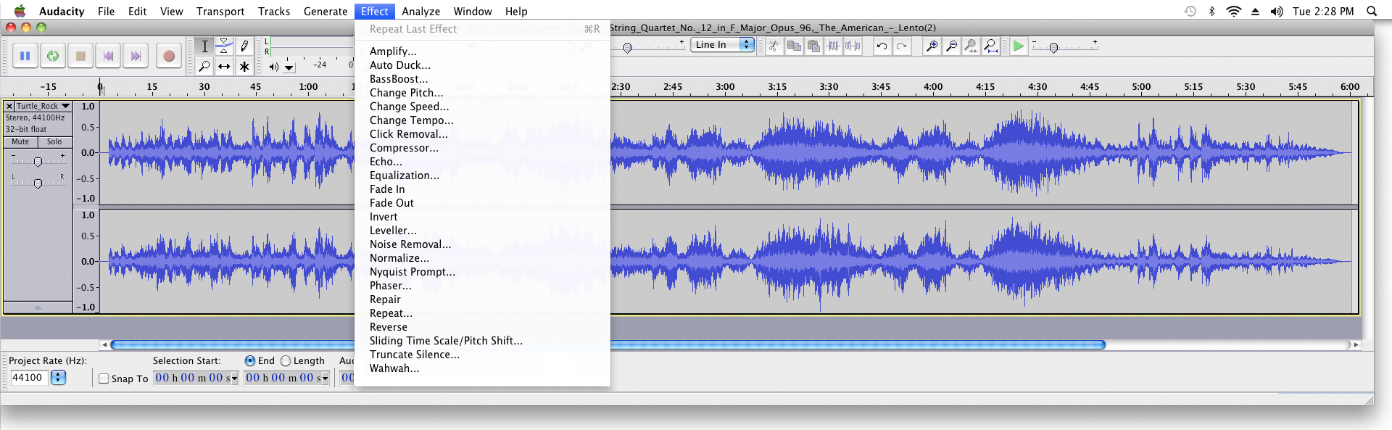

Slide 18
Editing Digital Recordings
Trimming: removing “dead air” or blank space from the front of a recording and any unnecessary extra time off the end.
Splicing and Assembly: assemble longer recordings by cutting and pasting together many shorter ones.
Volume Adjustments: while assembling multiple recordings into a single sound track, to provide a consistent volume level, select all the data in the file, raise or lower the overall volume by a certain amount.
Do not increase the volume too much, or you may distort the file.

Slide 19
Editing Digital Recordings
Multiple Tracks: edit and combine multiple tracks, and then merge the tracks and export them in a “final mix” to a single audio file.
Format Conversion: your digital audio editing software might read a format different from that read by your presentation or authoring program.
Use sound editing software to save files in your choice of many formats.
Data may be lost when converting formats.

Slide 20
Editing Digital Recordings
Resampling or Down-sampling: the sound is recorded at 16-bit sampling rates, but the lower rates and resolutions in the project, need to resample or down-sample the file.
Fade-ins and Fade-outs: fade in or fade out gradually, help to smooth out the beginning and the very end of a sound file.
Digital Equalization (EQ): modify a recording’s frequency content so that it sounds brighter (more high frequencies) or darker( low, ominous rumbles).

Slide 21
File Size vs. Quality
Sampling rate determines the frequency.
Sampling at higher rates (e.g., 44.1kHz or 22.05kHz) more accurately captures the high-frequency content of the sound.
Audio resolution (bit depth, sample size) (e.g. 8- or 16- bit) determines the accuracy with which sound can be digitized.
Using more bits for the sample size yields a recording that sounds more like its original.
The higher the sound quality, the larger the file will be.

Slide 22
File Size vs. Quality
Consumer-grade audio compact discs provide stereo at a sampling rate of 44.1kHz and 16-bit resolution.
Size of a monophonic digital recording =
duration of recording in seconds x sampling rate x (bit resolution/8) x 1.
Size of stereo recording =
duration of recording in seconds x sampling rate x (bit resolution/8) x 2.
e.g., 10-second stereo recording at 44.1kHz, 16-bit resolution (CD- quality):
10 X 44100 X 16/8 X 2 = 1,764,000 bytes = 1.76MB

Slide 23
MIDI Audio
MIDI (Musical Instrument Digital Interface): a communication standard developed in the early 1980s for electronic musical instruments and computers.
It allows music and sound synthesizers from different manufactures to communicate with each other by sending messages along cables connected to the devices.
MIDI provides a protocol for passing detailed descriptions of a musical score, such as the notes, the sequences of notes, and the instrument that will play these notes.

Slide 24
MIDI Audio
MIDI data is not digitized sound, it is a shorthand representation of music stored in numeric form.
A MIDI file is a list of time-stamped commands that are recordings of musical actions (e.g., the pressing down of a piano key).
Digital audio is a recording, MIDI is a score
Digital audio depends on the capabilities of your sound system, MIDI audio depends on the quality of your musical instruments and the capabilities of your sound system.
MIDI is device dependent.

Slide 25
MIDI Audio
Hard to create an original MIDI score,
To Make MIDI scores, need:
Notation software,
Sequencer software
Sound synthesizer (typically built into the software of multimedia players in most computers)
A MIDI keyboard
MIDI files are significantly smaller than equivalent digitized waveform files.
Embed MIDI files in web pages, load and play promptly.

Slide 26
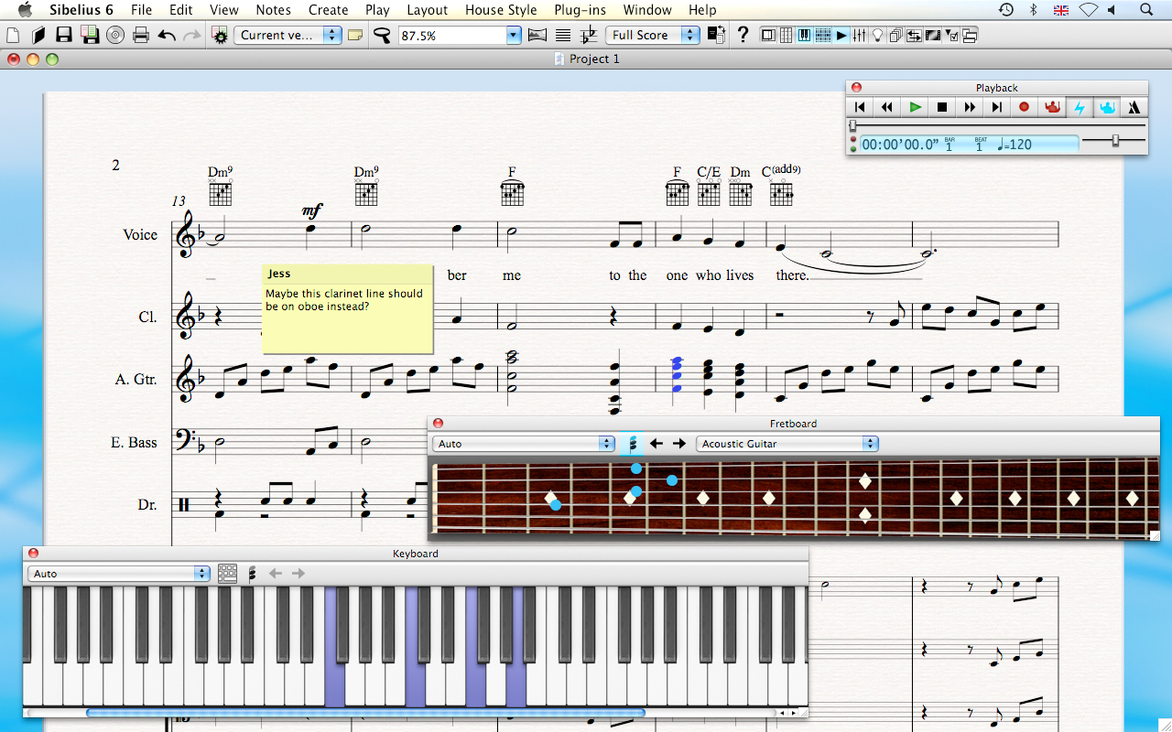
Notation and composition software, e.g., Sibelius, can create and arrange scores using MIDI instruments

Slide 27
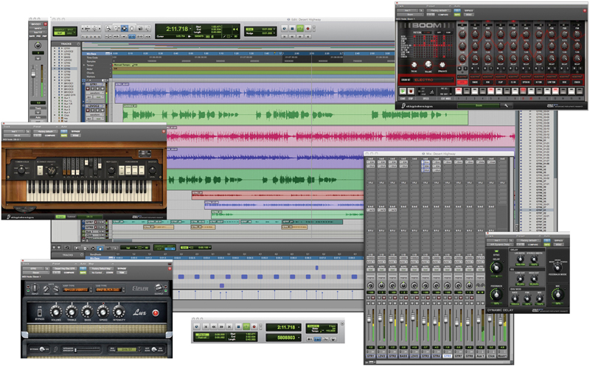
Sequencer software, e.g., Pro Tools, can record, edit, and save music generated from a MIDI keyboard or instruments and blend it with digital audio.

Slide 28
MIDI Audio
Since MIDI is device dependent and the quality of consumer MIDI playback hardware varies greatly, MIDI is used as a production tool rather than a delivery medium
MIDI is by far the best way to create original music.
In addition to describing the instrument and the note, MIDI data can also describe the envelope of the sound:
Attack (how quickly a sound’s volume increases)
Sustain (how long the sound continues)
Decay (how quickly the sound fades away)

Slide 29
MIDI vs. Digital Audio
Digital audio data is the actual representation of a sound, stored in the form of thousands of individual numbers (samples).
Digital audio data represents the instantaneous amplitude (loudness) of a sound at discrete slices of time.
MIDI data is device dependent, digital data is not.

Slide 30
MIDI vs. Digital Audio
Advantages of MIDI over digital audio:
MIDI files are much more compact (200- 1000 times smaller than CD-quality digital audio files).
The size of a MIDI file is completely independent of playback quality.
Small size makes MIDI appropriate for web pages, load and play more quickly.
With high quality sound source, MIDI sounds better.
You can change the length of a MIDI file without changing the pitch of the music or degrading the audio quality.
MIDI data is completely editable.

Slide 31
MIDI vs. Digital Audio
Disadvantages of MIDI over digital audio:
Hard to play back spoken dialog with MIDI, while digitized audio can do so with ease.
MIDI does not have consistent playback quality, while digital audio provides consistent playback quality.
One requires knowledge of music theory in order to run MIDI, while digital audio does not have this requirement.

Slide 32
Audio File Formats
A sound file’s format is a recognized methodology for organizing and compressing data bits of digitized sound into a data file.
Common sound formats:
Wav (Wave): uncompressed, Windows
Aiff (Audio Interchange File Format): uncompressed, Macintosh
FLAC (Free Lossless Audio Codec): lossless compression
Mp3 (MPEG-1 or MPEG2 Audio Layer III) : lossy compression
Ogg : similar to mp3, open-source
Wma (Windows Media Audio): lossy compression

Slide 33
Audio File Formats
Common sound formats:
Swf: Adobe flash file format, container for vector-based graphics and animations, text, video & sound delivered over the Internet.
Mov: apple’s QuickTime movie
Mp4: based on .mov, contains audio & video
AAC (Advanced Audio Coding), lossy compression, Apple’s iTunes store
M4A (MPEG for Audio): encoded with advanced audio coding (AAC)
M4A was generally intended as the successor to MP3
More: http://en.wikipedia.org/wiki/Comparison_of_audio_codecs

Slide 34
Audio File Formats
Common sound formats:
WAV/AIFF:
basically identical formats
WAV, supported-by-default format in windows - more popular.
Sound is stored completely uncompressed, similar to how it's stored on Audio CDs.
conversion is necessary to transfer files from/to audio CDs.
Because of their age and lack of encoding/decoding requirement they are usually default formats for audio creation and editing tools.

Slide 35
Audio File Formats
Common sound formats:
FLAC:
Lossless compressed format.
File size can typically be reduced to 50–60% and
Decompressed to an identical copy of the original audio data.
Playback support in portable audio devices and dedicated audio systems is limited compared to lossy formats like MP3.
A FLAC file can be converted to any other lossless format such as WAV and back without any loss of audio data.

Slide 36
Compressed Sound
An audio CD contains as much data as a regular data CD - 640 or 700MB.
That's used to represent 74 or 80 minutes of sound.
That's more than 8MB per minute.
Good reasons to compress sound
storage space
online streaming
Just as with images there are lossless and lossy compression types.

Slide 37
Compressed Sound
MP3
lossy but cuts down considerably the amount of disk space
First became popular when hard drives were small and it was the only accessible way to store music on a computer.
Later the popularity of the format exploded and these days every digital music player supports the format.
The algorithm relies on the fact that humans can't hear all sounds in all contexts.

Slide 38
Compressed Sound
OGG
Essentially equivalent to MP3 and was developed because of patents surrounding use of MP3.
OGG is not constrained by any patents, since it is open source and free to all.
Both OGG decoders (players) and encoders (creating tools) can be developed and distributed without a patent license.
Not all current players support OGG playback.
Require more processing power than MP3 to play.
A file in OGG format will have a smaller size compared to a file in MP3 format.

Slide 39
Compressed Sound
OGG
Older encoders can generate constant bitrate (CBR) files. Newer encoders can generate variable bitrate (VBR) files where the encoder chooses the bitrate on the fly depending on how much information is in the current sound segment.
E.g., with OGG, a 5 minute sound of silence will have a very small file size, or no size at all.
This is one of the main differences between OGG and MP3,
mp3 compresses digital data at a constant bit rate. Even when a particular track is completely silent, the file will still have a significant size.

Slide 40
Compressed Sound
OGG
Usually only for distribution, not used for recording or editing, because
(1) the encoding process is much more resource-intensive than decoding
(2) the format is lossy

Slide 41
Meta Data
Most audio formats (but not WAV and AIFF) can have metadata .
Usually includes the artist, album, and track name, the year, and genre.
Most playback software can be used to edit the metadata.
Format conversion software usually also copies the metadata into the appropriate fields.

Slide 42
Next week
animation

Slide 43
Thank you!

